Slide 1

Predicting Stock Exchange
Ruslan Gusiev
IronHack Data Analytics Bootcamp

Slide 2




What is love stock exchange?

Slide 3
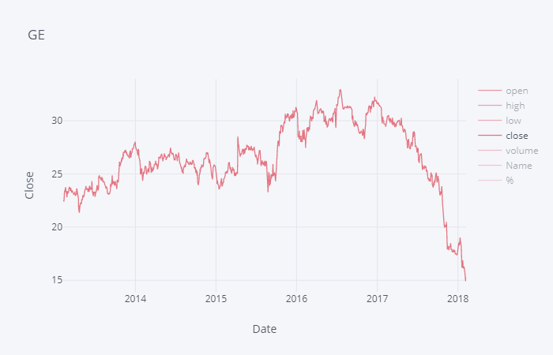
What trader sees?

Slide 4
Trend & anti-trend
buy
sell

Slide 5
Data (S&P 500)
2 datasets:
https://www.kaggle.com/camnugent/sandp500
https://datahub.io/core/s-and-p-500-companies/datapackage.json
Name – company name (505 companies)
Date (2013-02-08 – 2018-02-07)
Open, low, high, close – prices
Volume
Sector - company industry (11 sectors)
Market Cap – company capitalization

Slide 6
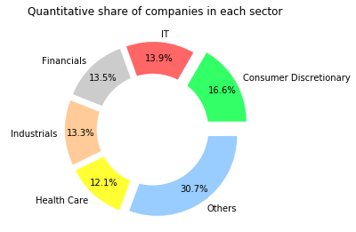
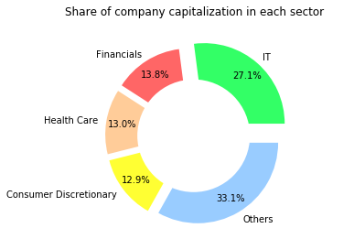
Share of companies by sector

Slide 7
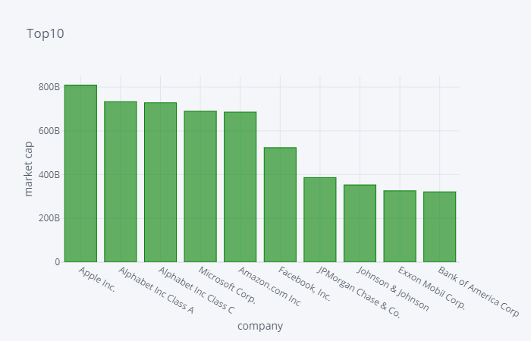
Top-10 companies by capitalization

Slide 8
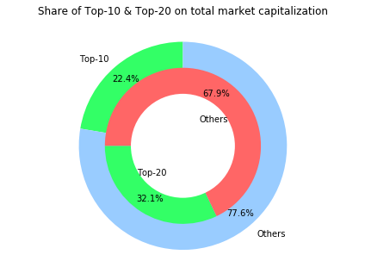
Share of Top-10 & Top-20

Slide 9
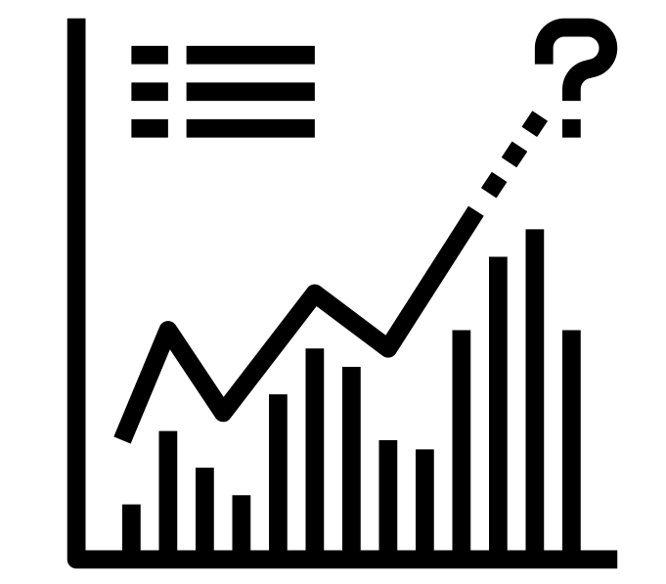
Can we predict Stock Exchange with ML?

Slide 10
Сlassical time series forecasting methods
Autoregression (AR)
Moving Average (MA)
Autoregressive Moving Average (ARMA)
Autoregressive Integrated Moving Average (ARIMA)
Seasonal Autoregressive Integrated Moving-Average (SARIMA)
Seasonal Autoregressive Integrated Moving-Average with Exogenous Regressors (SARIMAX)
Vector Autoregression (VAR)
Vector Autoregression Moving-Average (VARMA)
Vector Autoregression Moving-Average with Exogenous Regressors (VARMAX)
Simple Exponential Smoothing (SES)
Holt Winter’s Exponential Smoothing (HWES)

Slide 11
Сlassical time series forecasting methods
Autoregression (AR)
Moving Average (MA)
Autoregressive Moving Average (ARMA)
Autoregressive Integrated Moving Average (ARIMA)
Seasonal Autoregressive Integrated Moving-Average (SARIMA)
Seasonal Autoregressive Integrated Moving-Average with Exogenous Regressors (SARIMAX)
Vector Autoregression (VAR)
Vector Autoregression Moving-Average (VARMA)
Vector Autoregression Moving-Average with Exogenous Regressors (VARMAX)
Simple Exponential Smoothing (SES)
Holt Winter’s Exponential Smoothing (HWES)

Slide 12
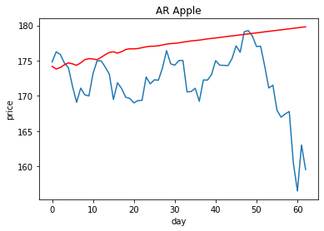
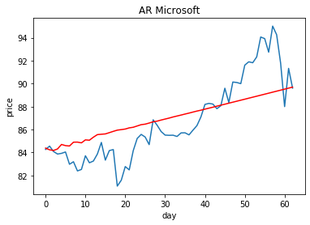
Autoregression (AR)
MSE = 52.827
MSE = 5.138

Slide 13
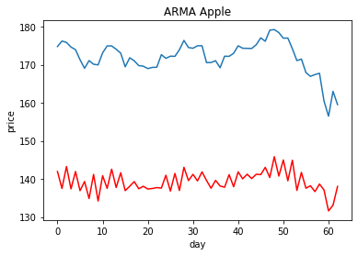
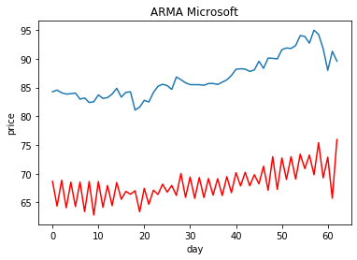
Autoregressive Moving Average (ARMA)
MSE = 1080.908
MSE = 351.154

Slide 14

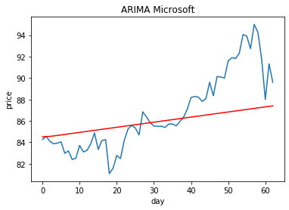
Autoregressive Integrated Moving Average (ARIMA)
MSE = 49.495
MSE = 8.400

Slide 15
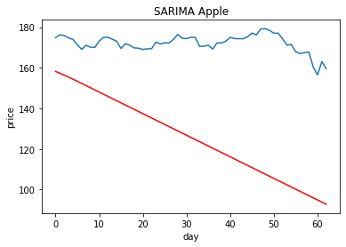
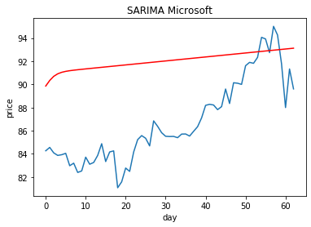
Seasonal Autoregressive Integrated Moving-Average (SARIMA)
MSE = 2491.303
MSE = 36.764

Slide 16
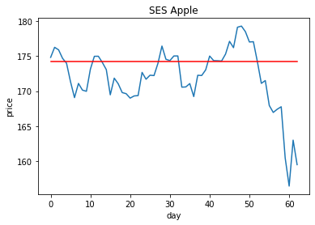
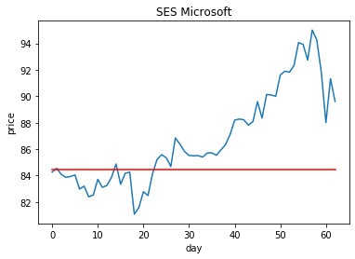
Simple Exponential Smoothing (SES)
MSE = 23.513
MSE = 17.471

Slide 17
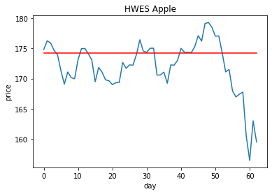
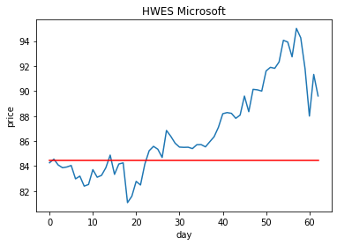
Holt Winter’s Exponential Smoothing (HWES)
MSE = 23.513
MSE = 17.471

Slide 18
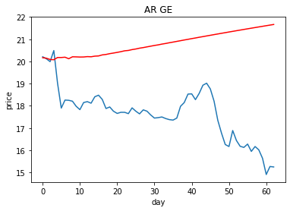
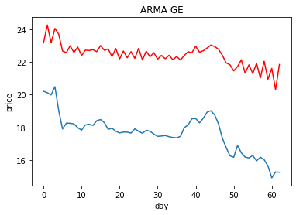
General Electric
MSE = 12.113
MSE = 22.970

Slide 19

Answer
Predicting future prices may work, but the risks are still quite high
The shorter the prediction period, the higher the chance to catch a trend (for 6 days prediction MSE=0.5)
Some machine learning models are not suitable for trending charts (SES & HWES)

Slide 20
Top-10 companies by capitalization

Slide 21


Slide 22


Our Team
Our Data

